Slide 1


AI in MDs
By Isabelle Carminati and Nicolas Calafiore
Fall 2024
EGN4912
AI generated

Slide 2
Course Timeline
OBJECTIVE
VALIDATE DATA
MODEL
OBJECTIVE
CURATE DATA
CURATE DATA
VALIDATE DATA
MODEL
Learn how to create a machine learning algorithm on movement disorders with a focus of Parkinson’s Disease. This model will be based off of our excel columns (Authors, Data Source, Abstract, etc.)
Utilize Mendeley to add scholarly articles found through query parameters on Google Scholar. Organized papers with relevant tags and categorized into folders based off of MD and type of study data.
Used Excel to input data from Mendeley into 16 columns. Developed a naming convention for consistency and to properly complete embeddings.
Create a clustering algorithm and classifier. Complete embeddings before moving onto clustering and classifier. Explore the best classifier (XGBoost, LightGBM, CatBoost)

Slide 3
OBJECTIVE
The objective of this project is to develop a machine learning algorithm specifically tailored to analyze movement disorders, with a primary focus on Parkinson’s Disease. The model will leverage a structured dataset organized in an Excel file, which includes columns such as Authors, Data Source, Abstract, and other relevant metadata. By utilizing these features, the algorithm will aim to classify, analyze, and potentially predict research trends or insights related to Parkinson’s Disease. This process will involve data preprocessing, feature selection, and applying machine learning techniques to extract meaningful patterns from the dataset, ultimately contributing to advancements in understanding and addressing movement disorders.
Learn how to select and analyze papers and strengthen our literature review skills.
Learn how to develop a machine learning algorithms such as classifiers and clustering.

Slide 4
Challenges
Familiarity
Choosing an Algorithm
First time either of us worked on code for machine learning algorithms
Had to learn and familiarize ourselves with movement disorders
Stuck between completing 1 or 2 algorithms
Worried about time in regards to completing a classifier over a clustering algorithm
Clarity
Excel
Throughout the project, there was some confusion in regards to our end goal
Clarity on overall expectations
Starting the excel after finding articles
Time consuming to go back into mendeley

Slide 5
CURATE DATA
Effectively utilize Mendeley as a tool to manage and organize scholarly articles sourced through specific query parameters on Google Scholar. The process involves importing relevant articles into Mendeley, tagging them with appropriate keywords, and categorizing them into folders based on their relevance to movement disorders (MD) and the type of study data they provide. This structured organization will streamline research workflows, facilitate quick access to key studies, and enhance the overall efficiency of analyzing and referencing literature in the field of movement disorders.
Main task that supports our objective learning goal of literature review & analysis
Learned about useful research tools to support data curation and future endeavors
UF VPN
Litmaps & Connected Papers
Reveal Hidden Papers

Slide 6
Challenges
Time
Finding Papers
Underestimated the time consumption
Some weeks we did not meet expectations for article amount
For lesser studied diseases, papers were more difficult to find
Can affect our algorithm
Amount Found
Mendeley
Though we found almost 500 papers, only about 200 made it into our algorithm
Under time constraints not all papers were added into csv file due to lengthy analysis time
Experienced glitches which made the process longer
Time consuming to add tags and categorize papers

Slide 7
VALIDATE DATA
Use Excel to input and structure data extracted from Mendeley into a comprehensive format across 16 defined columns. A standardized naming convention is developed to ensure consistency and accuracy in the dataset, enabling seamless integration and preparation for embedding-based analysis. This systematic approach ensures that the data is uniformly formatted and ready for further processing in downstream machine learning or analytical workflows.
Visualized data to check for issues such as duplicate cells or spelling errors
Create a naming convention that’s agreed upon by all members

Slide 8
Challenges
Naming Convention
Fixing Data
Determining an appropriate yet simple convention
Handling acronyms
A lot of data cells to correct
Spelling errors and capitalization inconsistencies
Algorithm Acronyms
Unclear Expectations
What should and shouldn’t be simplified
Reanalyzing article to ensure correct algorithm
CSV file had more categories added throughout the project
Time consuming to go back and reanalyze data

Slide 9
MODEL
Develop a clustering algorithm and a robust classifier to analyze the dataset. The process begins with completing embeddings to represent the data in a meaningful vectorized format, ensuring optimal input for both clustering and classification models using
“PubMedBert-MS-MARCO”. Once the embeddings are prepared, clustering algorithms will be implemented to group similar data points, followed by the creation of a classifier to categorize the data effectively. The project will involve exploring and comparing advanced classifiers such as XGBoost, LightGBM, and CatBoost to identify the most suitable model for the dataset, optimizing performance and accuracy.
Find K amount using gap statistic and clustering
Based off of embeddings we can further explore classifier type

Slide 10
Challenges
Encoding
Learning Curve
Finding an optimal encoder
Finding appropriate visualizations
Understanding given code and applying
Outdated
Referenced code works with older versions of python and libraries
Configuring working environment by downgrading

Slide 11

Data
Visualizations
Analyzing our CSV file…

Slide 12
Objective
We want to showcase the data used for our algorithm and the respective trends.
We also want to help our audience understand the trends and readings behind why those trends exist.
Additionally we made our visualizations appealing and readable through plotting libraries (Numpy & Matplotlib).

Slide 13
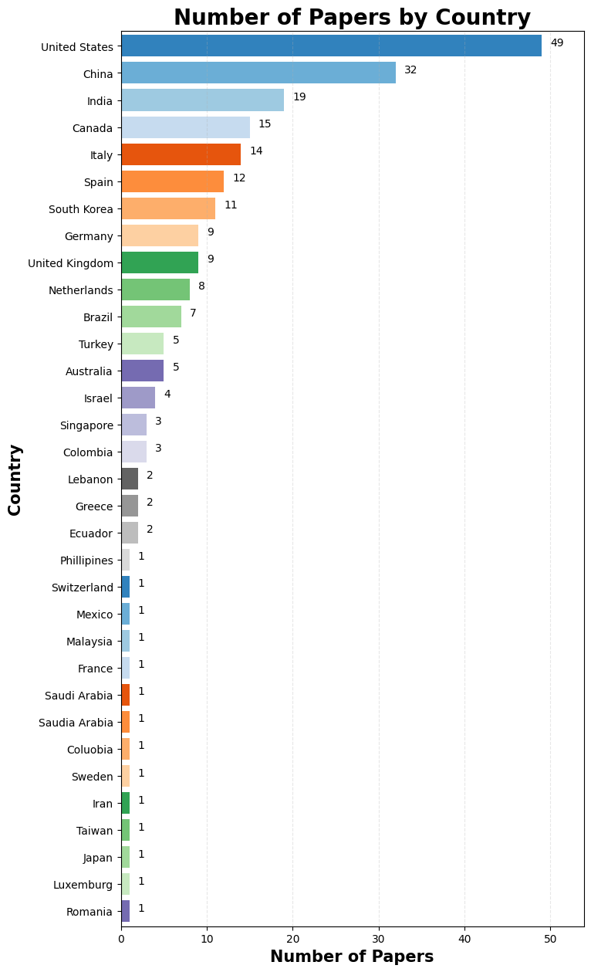
PAPERS BY COUNTRY
What does this mean?
Amount of Countries: 32
United States leads with 49 papers out of the 220 papers
China follows with 32 papers and India with 19
Why?
The US may be in the lead since we searched for papers that were written in English
The US is a melting pot of research and homes the top educational institutions

Slide 14
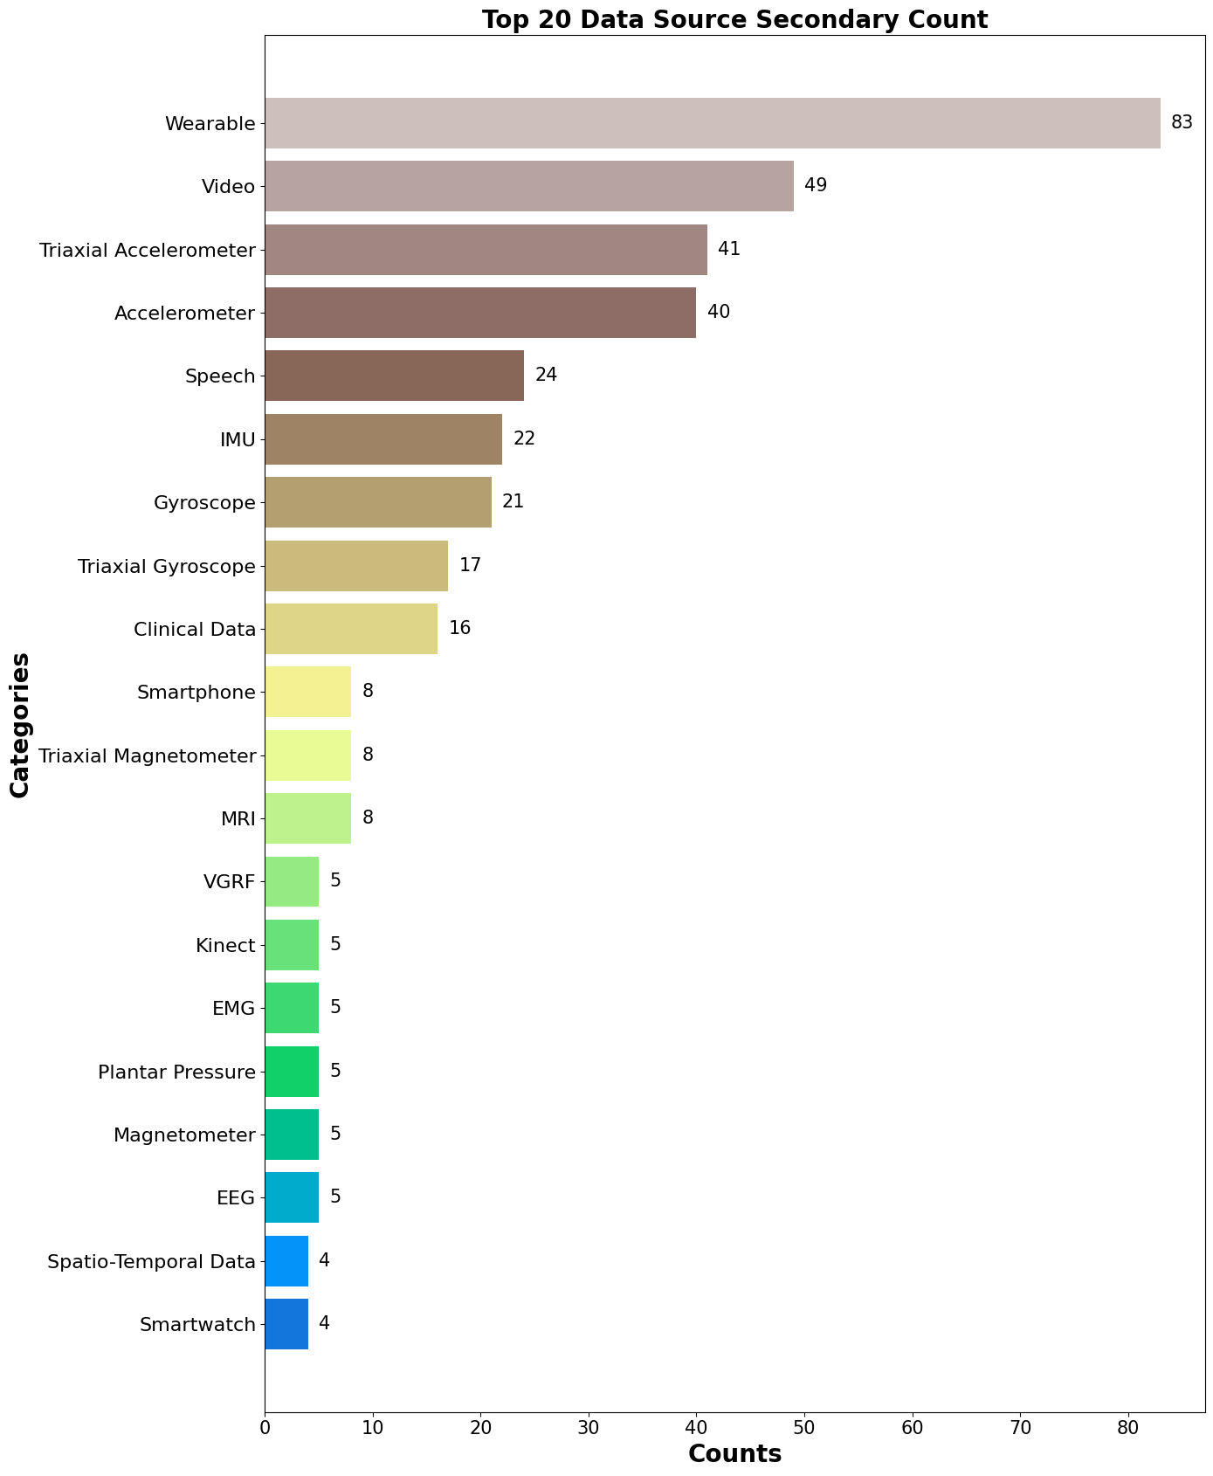
DATA SOURCE SECONDARY
What does this mean?
Amount of DSS: 71, showcasing top 20
Wearables and videos are most popular
Why?
Wearables are the easiest method to track certain variables with how much technology is advancing
Videos are likely popular as they are integrated into the study’s machine learning algorithm.
Notes:
VGRF: Vertical Ground Reaction Force

Slide 15
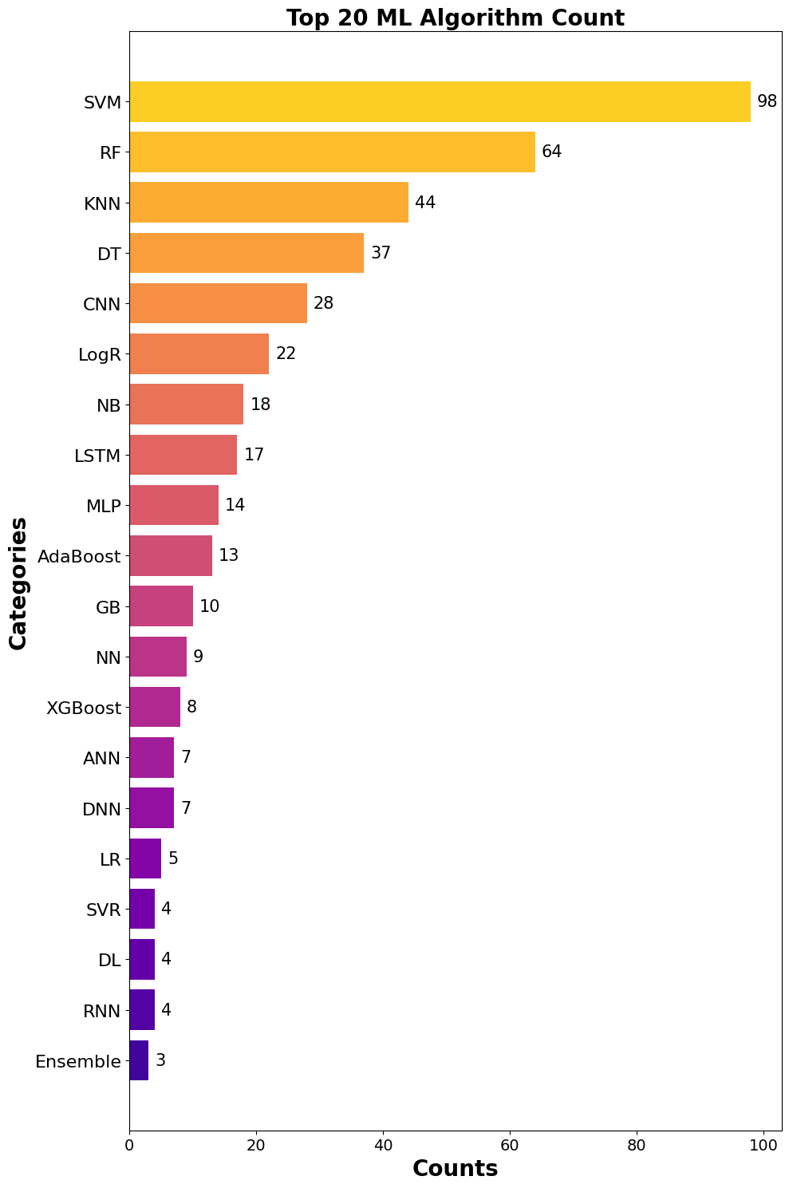
ALGORITHMS
What does this mean?
Amount of distinct algorithms: 173, showcasing top 20
SVM (majority) , RF, and KNN are most popular
Why?
SVMS are effective for classification tasks, and most of the research articles have a common goal of classifying an MD.
In terms of classifications, KNN is simple and RF is versatile which works with classifications and regression problems
Notes:
Support Vector Machine (SVM), Random Forest (RF), K-Nearest Neighbors (KNN), Decision Tree (DT), Convolutional Neural Network (CNN), Logistic Regression (LogR), Naive Bayes (NB), Long Short-Term Memory (LSTM), Multi-Layer Perceptron (MLP), Adaptive Boosting (AdaBoost), Gradient Boosting (GB), Neural Network (NN), Extreme Gradient Boosting (XGBoost), Artificial Neural Network (ANN), Deep Neural Network (DNN), Linear Regression (LR), Support Vector Regression (SVR), Deep Learning (DL), Recurrent Neural Network (RNN), Ensemble Methods (Ensemble)

Slide 16
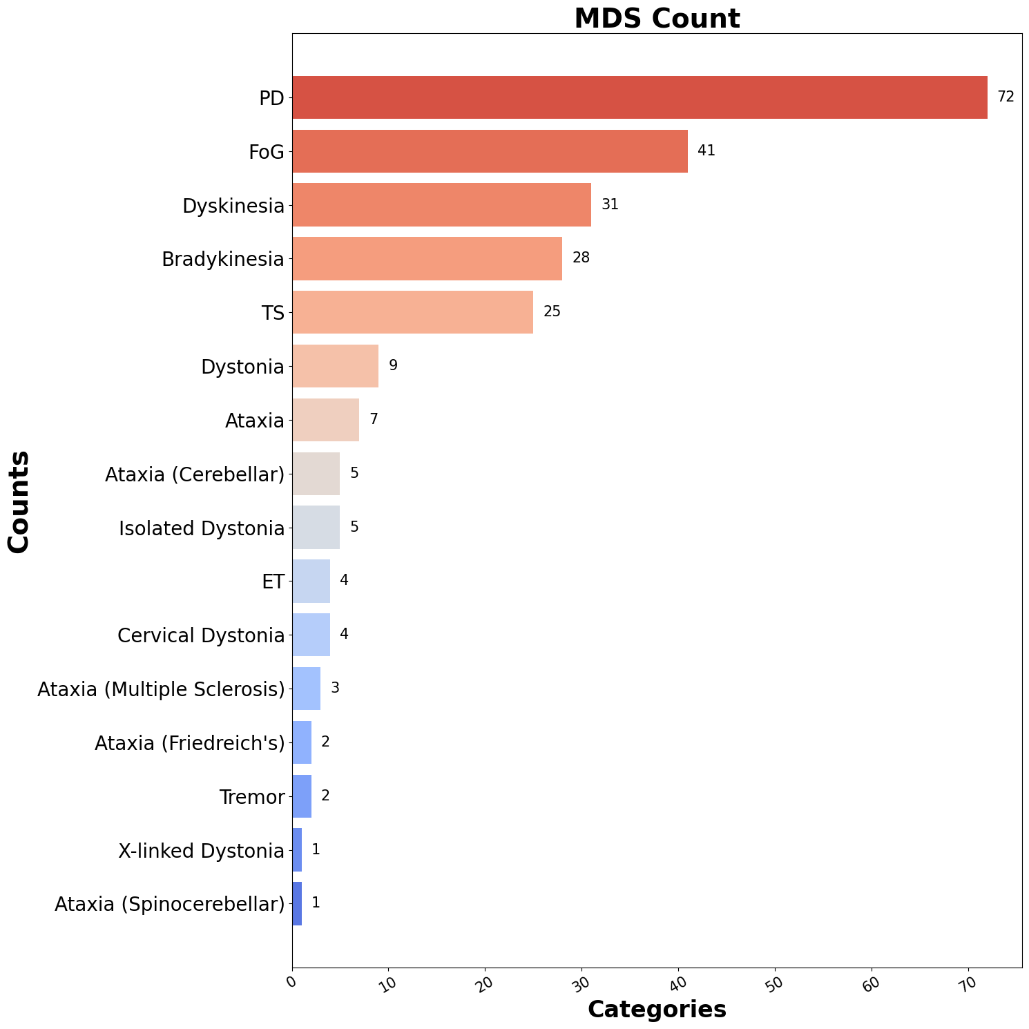
MDS
What does this mean?
PD, FoG, and Dyskinesia are the most popular
Ataxia is popular too, but we broke it down into types of Ataxia for accuracy
Why?
PD is our main focus and we looked for data that included PD and a movement disorder related to PD, it makes sense to be the top count

Slide 17
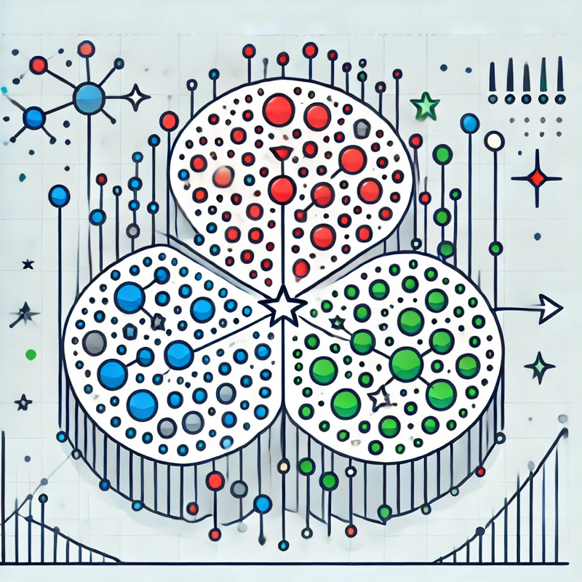
K-Means
Clustering
Where things get interesting…

Slide 18
Objective
Demonstrating the clustering for all columns in our data in a concise and visually appealing manner
We’d also like to showcase the importance of accuracy with encoding your data. We’ll observe some differences found with our encoders.
Examples will be shown as we demonstrate our KNN clusterings.

Slide 19
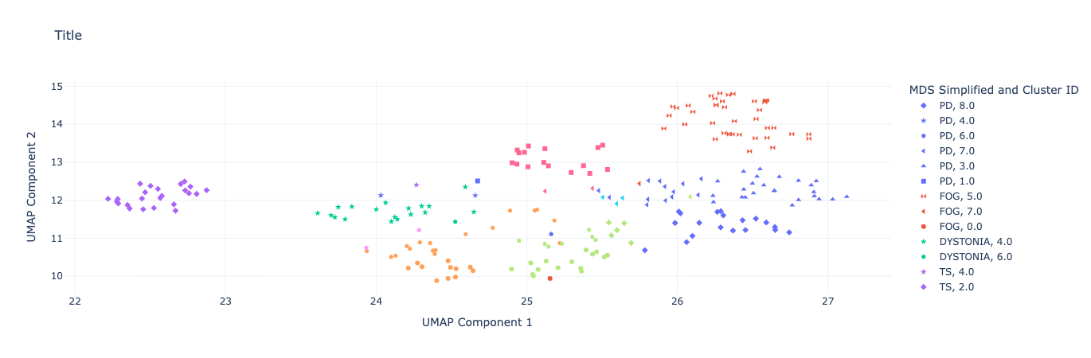
PAPERS:
Number of Clusters: 8

Slide 20
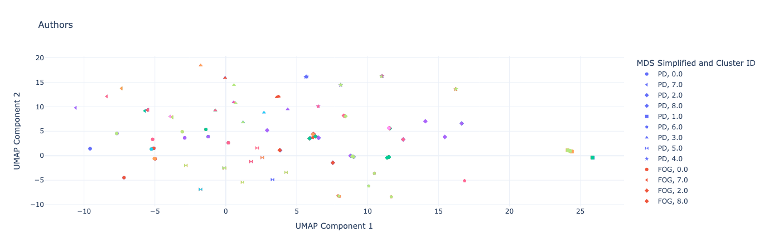
AUTHORS:
Number of Clusters: 2

Slide 21
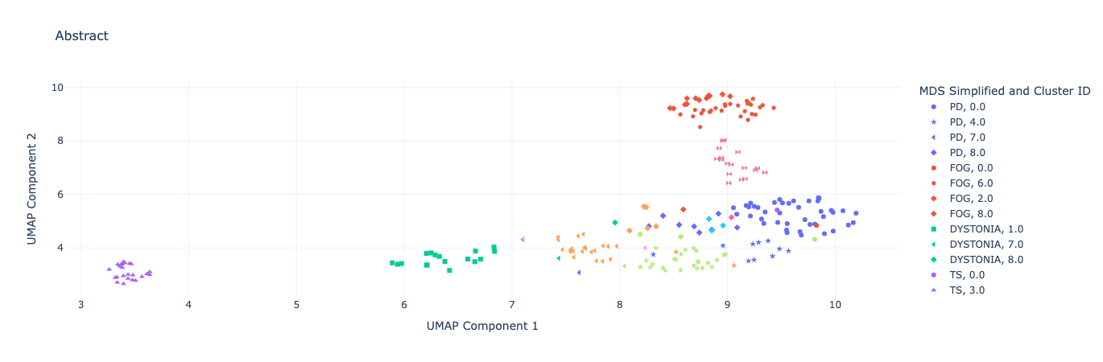
ABSTRACT:
Number of Clusters: 9

Slide 22
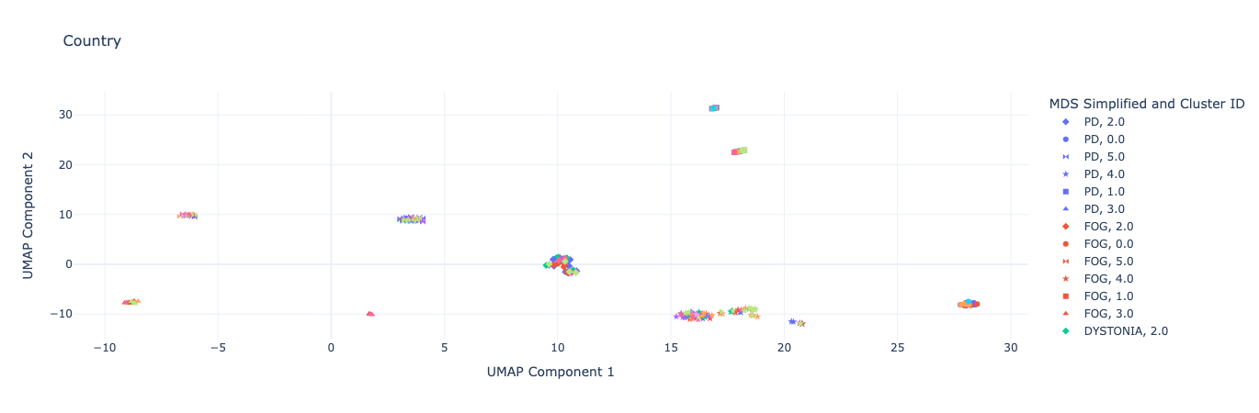
COUNTRY:
Number of Clusters: 8

Slide 23
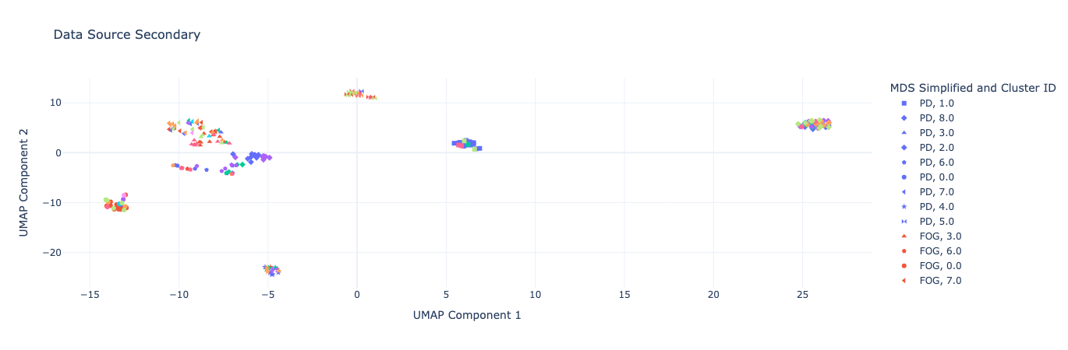
DATA SOURCE SECONDARY:
Number of Clusters: 8

Slide 24
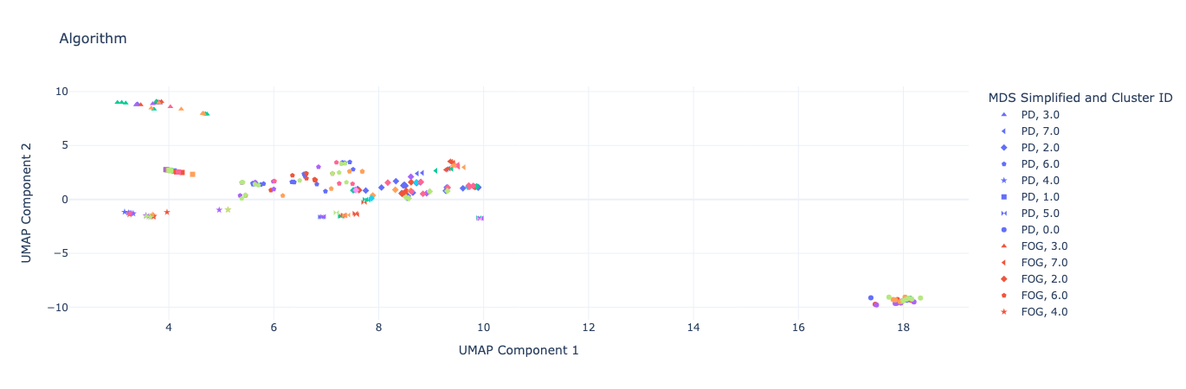
ALGORITHM:
Number of Clusters: 7

Slide 25
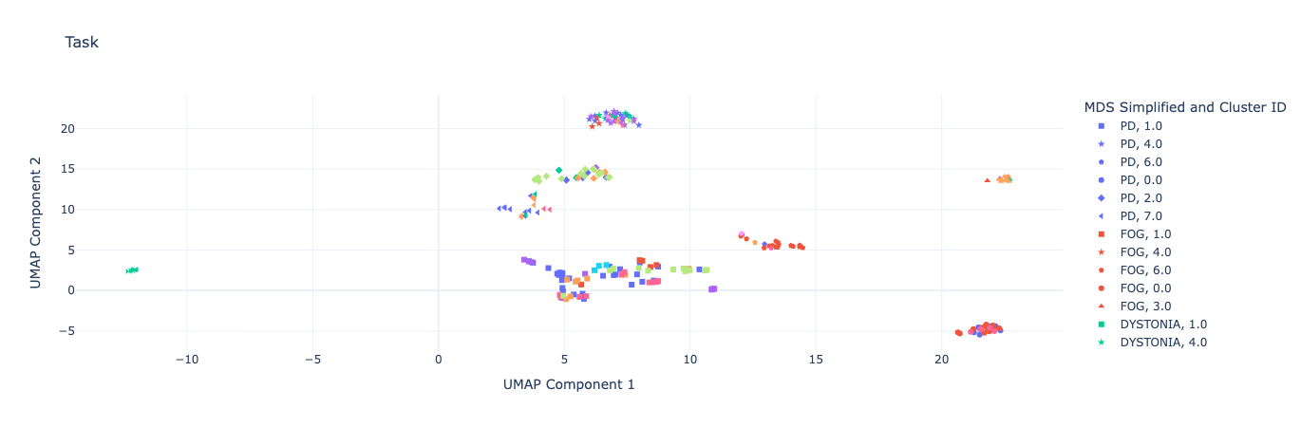
TASK:
Number of Clusters: 9

Slide 26
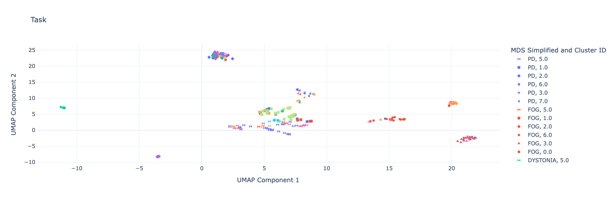
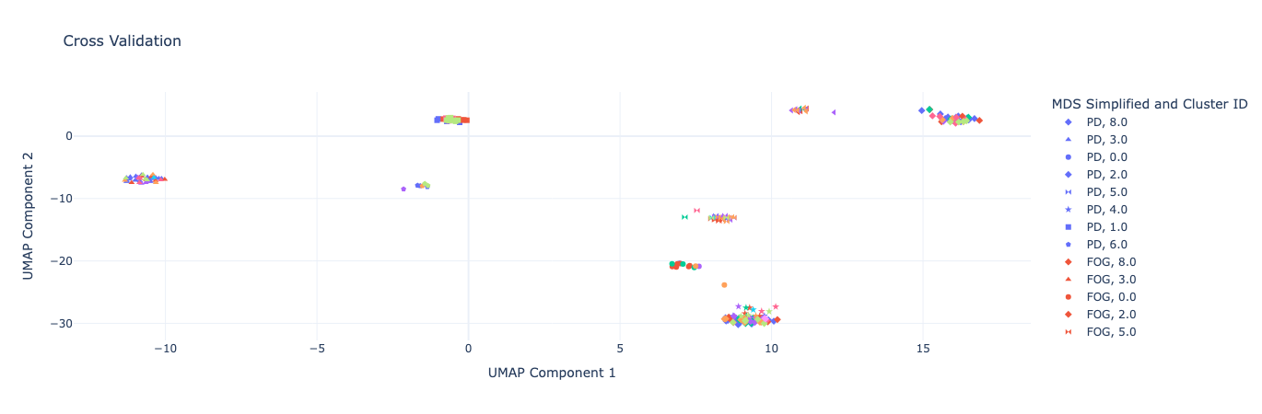
CROSS VALIDATION:
Number of Clusters: 6

Slide 27
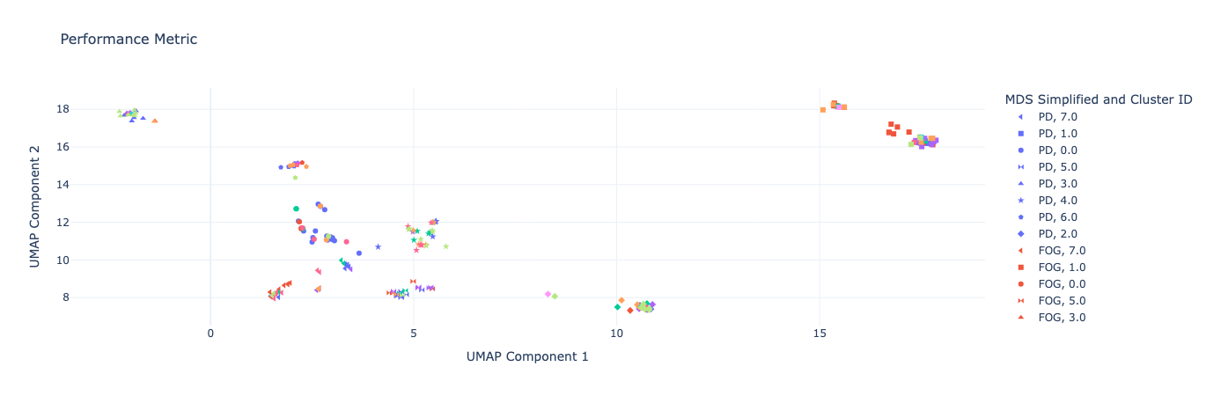
PERFORMANCE METRIC:
Number of Clusters: 9

Slide 28
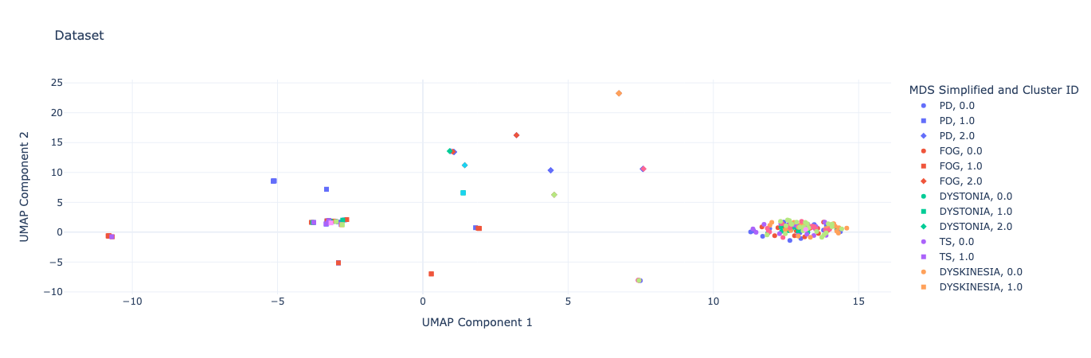
DATASET:
Number of Clusters: 8

Slide 29
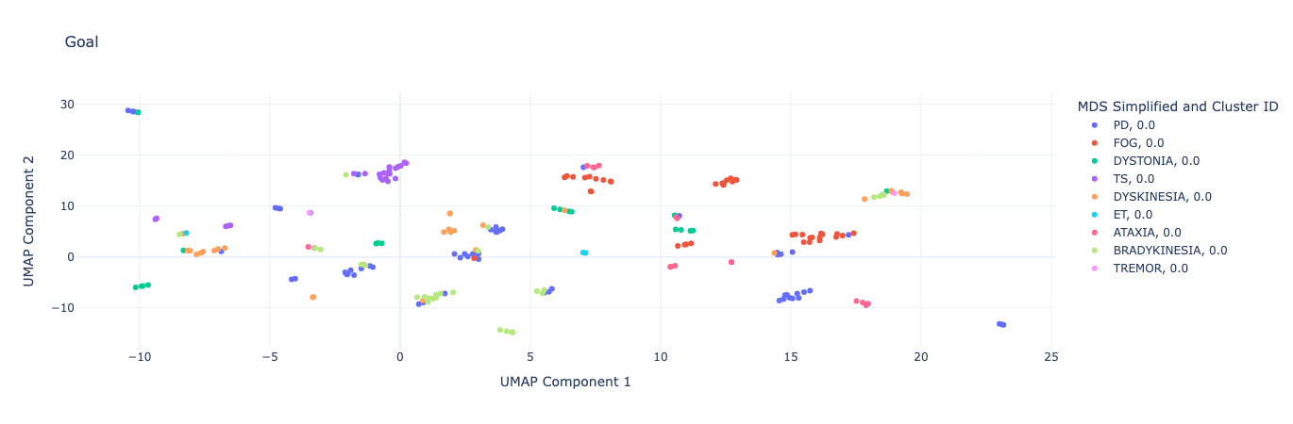
GOAL:
Number of Clusters: 8

Slide 30
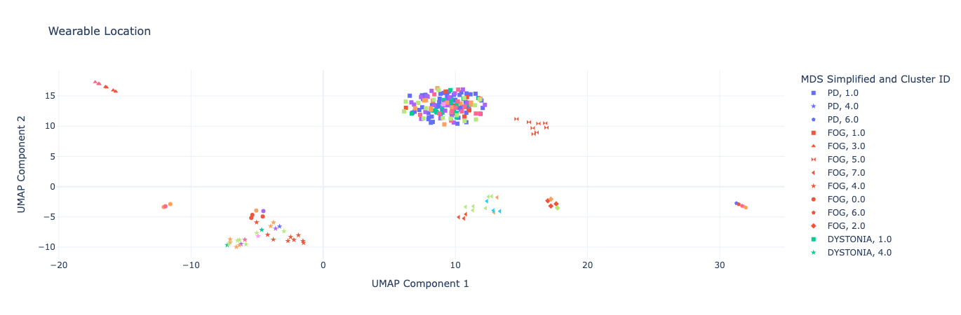
WEARABLE LOCATION:
Number of Clusters: 9

Slide 31
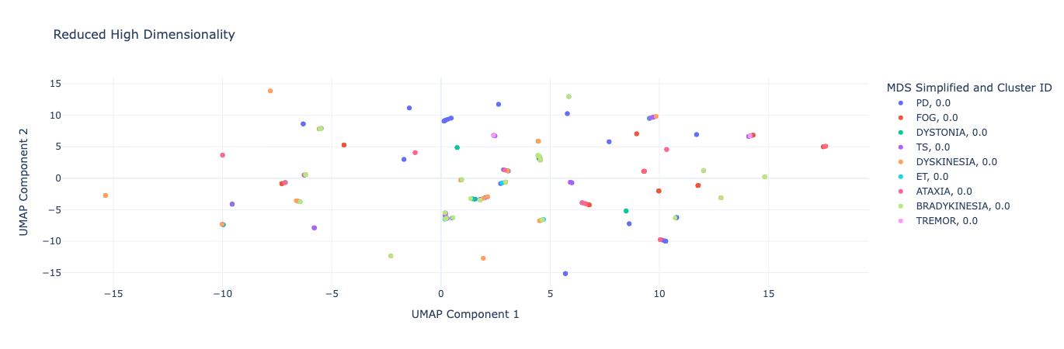
HIGH DIMENSIONALITY:
Number of Clusters: 1

Slide 32
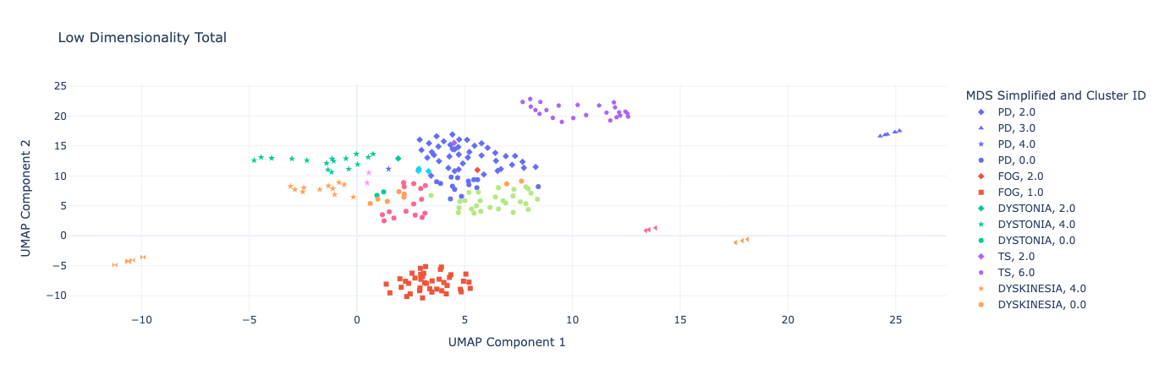
LOW DIMENSIONALITY:
Number of Clusters: 9

Slide 33
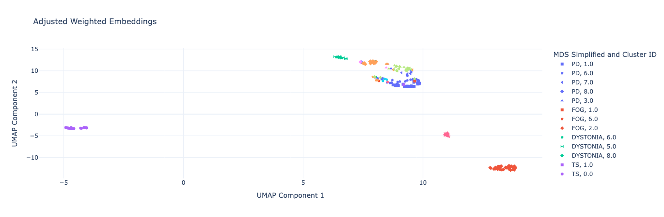
ADJUSTED WEIGHTED EMBEDDINGS:
Number of Clusters: 9

Slide 34
Takeaways
During the clustering process, we initially thought that the difference in clusters was due to the encoding
Upon trial and error we saw that the encoder didn’t make a big difference at all.
It turns out that the clustering we used utilizes randomizations
Different cluster everytime
Our data could be better and more diverse as there aren’t as many clusters as we hoped
What we learned…

Slide 35
What happens when we use an incorrect encoder?
Encoding is crucial when reading a CSV file because it determines how the text in the file is interpreted. Different encoding formats handle text differently, particularly non-ASCII characters, and incorrect encoding can lead to errors or misrepresentation of data.
Originally the encoder, ASCII, was used but threw errors. We used UTF-8 instead which is essentially ASCII, but includes error handling to ignore unreadable data…
The next slide demonstrates the impact of having an incorrect encoder…

Slide 36
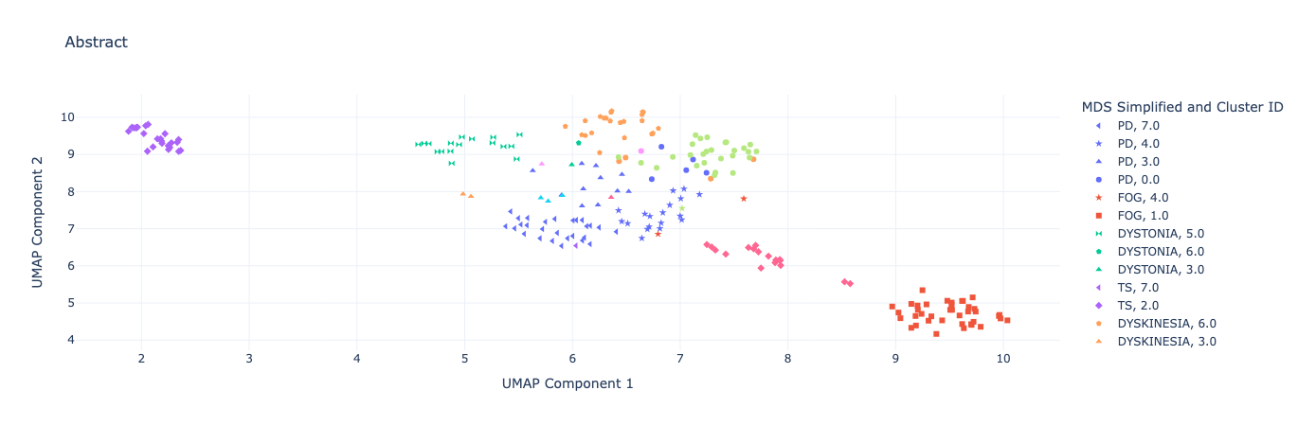
ISO-8859-1 VS UFT-8
Notice the difference in clusterings:
Clusters are less defined
More spread out
Significant overlaps
This could lead to further issues when doing data analysis with incorrect trends.

Slide 37

Machine Learning
Classifier
Leveling up from our clustering…

Slide 38
Choosing a Classifier
XGBoost
CatBoost
LightGBM
Robust and Accurate: Delivers competitive performance but requires more preprocessing.
Resource Intensive: Slightly slower than LightGBM and CatBoost, especially with many categorical features.
Consideration: Use XGBoost if comfortable preprocessing and optimizing for performance through hyperparameter tuning.
Best for Categorical Features: With our dataset having lots of categorical features, excels without requiring much preprocessing
Ease of Use: Minimal hyperparameter tuning is required for strong performance.
Consideration: Highly recommended for efficiency without extensive preprocessing.
Fast and Scalable: Excellent for larger datasets with numeric embeddings. Also works well with categorical features when encoded.
Missing Value Handling: Can handle missing values directly.
Consideration: Might need to encode categorical variables manually for optimal performance, adding some preprocessing steps. See if compatible with current embeddings/encodings.

Slide 39
Making the Model Work
Preprocessing:
Encoded data
Handle missing data
Used low dimensionality
Splitting the Data:
Divide dataset for training and testing(80-20 split)
Training for learning, testing for performance measurement
Training the Model:
Train each model with relevant hyperparameters
Monitor training progress with metrics (log-loss)
Evaluation:
Assess performance through metrics
Compare all models
Utilize log loss to stop if validation metric doesn’t improve for 10 rounds
Notes:
Missing Data replaced with an empty string in code

Slide 40
Evaluation Metrics
Support:
The number of actual instances for each category
Precision:
How many of the predictions labeled as a specific category are actually correct.
Recall:
How many of the actual instances of a specific category the model correctly identified.
F1-Score:
Balance between precision and recall, representing the overall effectiveness of the model for a specific category

Slide 41
XGBoost
Analysis of output:
1. Initial Log-Loss:
• Train[0]: 1.96491, Test[0]: 1.96389
2. Final Log-Loss:
• Train[80]: 0.15526, Test[80]: 0.32207
The test log-loss is significantly reduced, indicating the model has learned meaningful patterns.
3. Log-Loss Test
• Value = 0.3221
Defines the value bifurcation between the presumed probability label and the true one. Numerical values between 0-1, the lower the value the better.
Final accuracy: 93.3%
Notes:
INitial log loss should be high as this is expected since the model starts without much learning. Train index is number of boost round where trees are trained.

Slide 42
Classification Report
Precision Recall F1-Score Support
0 1.00 1.00 1.00 3
1 1.00 1.00 1.00 7
2 0.83 0.83 0.83 6
3 0.80 0.67 0.73 6
5 1.00 1.00 1.00 12
6 0.90 1.00 0.95 9
8 1.00 1.00 1.00 2
Accuracy: 0.93 45
Weighted avg: 0.93 0.93 0.93 45
Confusion Matrix:
[[ 3 0 0 0 0 0 0]
[ 0 7 0 0 0 0 0]
[ 0 0 5 1 0 0 0]
[ 0 0 1 4 0 1 0]
[ 0 0 0 0 12 0 0]
[ 0 0 0 0 0 9 0]
[ 0 0 0 0 0 0 2]]

Slide 43
CatBoost
Analysis of output:
1. Initial Log-Loss:
• Train[0]: 2.0109432, Test[0]: 2.0243136
2. Final Log-Loss:
• Train[99]: 0.2739859 Test[99]: 0.2303621
The test log-loss is significantly reduced, indicating the model has learned meaningful patterns.
3. Log-Loss Test
• Value = 0.2304
Defines the value bifurcation between the presumed probability label and the true one. Numerical values between 0-1, the lower the value the better.
Final accuracy: 97.8%
Notes:
INitial log loss should be high as this is expected since the model starts without much learning. Train index is number of boost round where trees are trained.

Slide 44
Classification Report
Precision Recall F1-Score Support
0 1.00 1.00 1.00 3
1 0.88 1.00 0.93 7
2 1.00 1.00 1.00 6
3 1.00 1.00 1.00 6
5 1.00 1.00 1.00 12
6 1.00 0.89 0.94 9
8 1.00 1.00 1.00 2
Accuracy: 0.98 45
Weighted avg: 0.98 0.98 0.98 45
Confusion Matrix:
[[ 3 0 0 0 0 0 0]
[ 0 7 0 0 0 0 0]
[ 0 0 6 0 0 0 0]
[ 0 0 0 6 0 1 0]
[ 0 0 0 0 12 0 0]
[ 0 1 0 0 0 8 0]
[ 0 0 0 0 0 0 2]]

Slide 45
LightGBM
Analysis of output:
1. Initial Log-Loss:
• Train[0]: 2.0109432,
2. Final Log-Loss:
Not Given
3. Log-Loss Test
• Value = 0.3199
Defines the value bifurcation between the presumed probability label and the true one. Numerical values between 0-1, the lower the value the better.
Final accuracy: 88.89%
Notes:
INitial log loss should be high as this is expected since the model starts without much learning. Train index is number of boost round where trees are trained.

Slide 46
Classification Report
Precision Recall F1-Score Support
0 1.00 1.00 1.00 3
1 0.71 0.71 0.71 7
2 0.86 1.00 0.92 6
3 0.86 1.00 0.92 6
5 1.00 1.00 1.00 12
6 0.88 0.78 0.82 9
8 1.00 0.50 0.67 2
Accuracy: 0.89 45
Weighted avg: 0.89 0.89 0.88 45
Confusion Matrix:
[[ 3 0 0 0 0 0 0]
[ 0 5 1 0 0 1 0]
[ 0 0 6 0 0 0 0]
[ 0 0 0 6 0 0 0]
[ 0 0 0 0 12 0 0]
[ 0 2 0 0 0 7 0]
[ 0 0 0 1 0 0 1]]

Slide 47
MODEL COMPARISON
Model: | Final Loss Log: | Avg Accuracy: | Avg Precision: | Avg F1:
XGBoost | .32 | .93 | .93 | .93
CatBoost | .23 | .98 | .98 | .98
LightGBM | .31 | .89 | .89 | .88

Slide 48

Live Coding
Watch our algorithm in action…
Notes:
Showcase fake data and their predictions

Slide 49
What We Learned
Data Curation
Validation
Hands on Experience
Mastered tools like Mendeley
Learned how to find scholarly articles
Significance of encoding and its impact on clusters
Small room for error as data is sensitive
Implemented advanced machine learning algorithms
Implemented a clustering algorithm
Insights
Problem Solving
Professional Growth
Learned about our data quality
Model performance measured through evaluation metrics
Handled challenges with older codebases
Faced the learning curve
Learned to adapt and thrive in unexpected challenges
New skill set for future employers

Slide 50
Questions?

Slide 51



Thank you to our Contributors
Thank you Ricardo and Ben for taking us as students and giving us the opportunity to learn! We’ve learned many valuable skills applicable to our professional and personal lives. This has been a truly valuable experience.
Isabelle Carminati
Nicolas Calafiore
Ricardo Diaz-Rincon
Undergraduate Junior
Computer Science & Portuguese
Undergraduate Senior
Computer Science
PHD Student and Mentor
Neuroscience
We’d also like to thank Ricardo for being so understanding and helpful, as this semester was full of ups and downs.

